Slide 1

Azure SQL DB and REST endpoints to enable AI content moderation
Brian Spendolini
Muazma Zahid

Slide 2
Goals
Learn how to invoke external REST endpoints from Azure SQL Database using sp_invoke_external_rest_endpoint without having to write complex code or functions. This hands-on lab will walk you through setting up AI-assisted content moderation using Azure SQL Database and REST endpoints.
Understand of how to use stored procedures to make REST calls to
Azure AI Content Safety
Azure OpenAI
Azure AI Language
How to extend this approach to other AI scenarios, such as language processing and generative AI
https://github.com/AzureSQLDB/ContentSafetyLab/

Slide 3
Agenda
aka.ms/sqlai aka.ms/sqlaisamples
Creating and connecting to your free Azure SQL Database
Getting started with REST in the database
Using the Azure AI Language REST endpoints
Using the Azure AI Content Safety endpoints
Using Azure OpenAI with your data
Expanding your knowledge
What’s possible
https://github.com/AzureSQLDB/ContentSafetyLab/

Slide 4
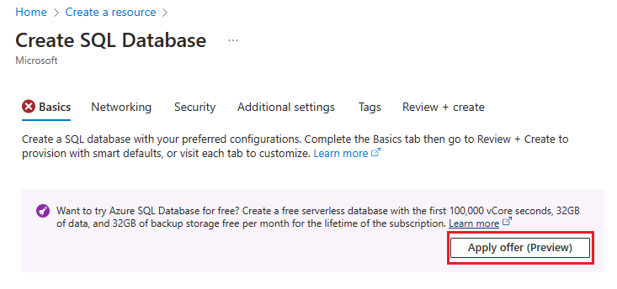
Creating and connecting to your free Azure SQL Database
Create a free Azure SQL Database (aka.ms/freedb)
https://github.com/AzureSQLDB/ContentSafetyLab/

Slide 5
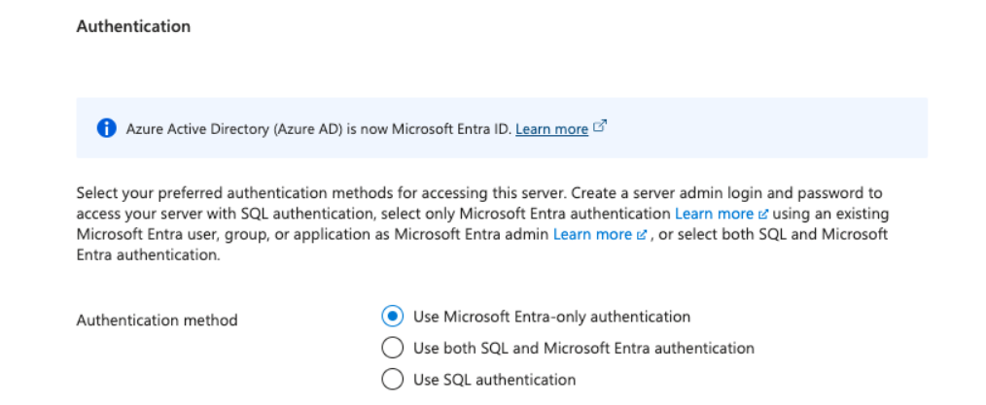
Use Entra-only Authentication
https://github.com/AzureSQLDB/ContentSafetyLab/

Slide 6
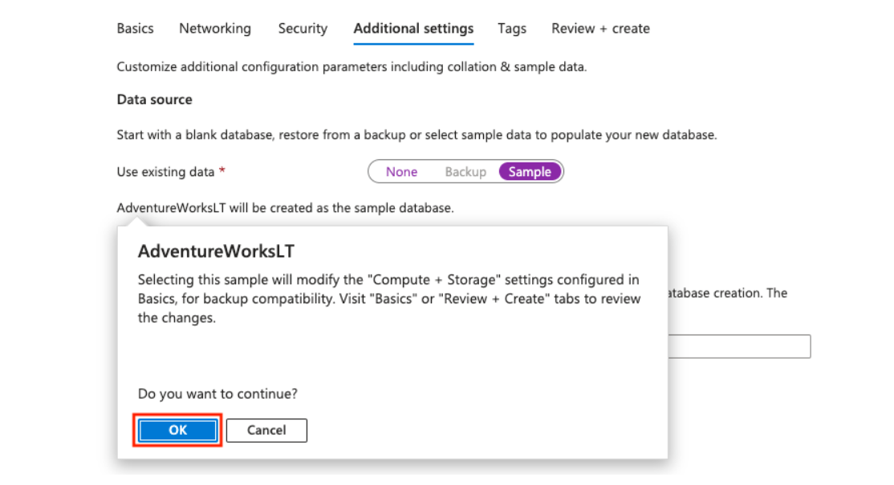
Start with a Sample Database
https://github.com/AzureSQLDB/ContentSafetyLab/

Slide 7
Call REST services from the Azure SQL Database
Using sp_invoke_external_rest_endpoint
DECLARE @ret INT, @response NVARCHAR(MAX);
EXEC @ret = sp_invoke_external_rest_endpoint
@url = N'https://restmcrestface.azurewebsites.net/api/resttest',
@method = 'GET',
@headers = '{"Accept": "text/*"}',
@payload = null,
@timeout = 230,
@response = @response OUTPUT;
SELECT @ret AS ReturnCode, @response AS Response;
https://github.com/AzureSQLDB/ContentSafetyLab/

Slide 8

Azure AI Language https://learn.microsoft.com/en-us/azure/ai-services/language-service/
AI Language Feature | Description
Named Entity Recognition (NER) | Named entity recognition is a preconfigured feature that categorizes entities (words or phrases) in unstructured text across several predefined category groups. For example: people, events, places, dates, and more.
Personally identifying (PII) and health (PHI) information detection | PII detection is a preconfigured feature that identifies, categorizes, and redacts sensitive information in both unstructured text documents, and conversation transcripts. For example: phone numbers, email addresses, forms of identification, and more.
Language detection | Language detection is a preconfigured feature that can detect the language a document is written in and returns a language code for a wide range of languages, variants, dialects, and some regional/cultural languages.
Sentiment Analysis and opinion mining | Sentiment analysis and opinion mining are preconfigured features that help you find out what people think of your brand or topic by mining text for clues about positive or negative sentiment and can associate them with specific aspects of the text.
Summarization | Summarization is a preconfigured feature that uses extractive text summarization to produce a summary of documents and conversation transcriptions. It extracts sentences that collectively represent the most important or relevant information within the original content.
Key phrase extraction | Key phrase extraction is a preconfigured feature that evaluates and returns the main concepts in unstructured text and returns them as a list.
Entity linking | Entity linking is a preconfigured feature that disambiguates the identity of entities (words or phrases) found in unstructured text and returns links to Wikipedia.
Text analytics for health | Text analytics for health is a preconfigured feature that extracts and labels relevant medical information from unstructured texts such as doctor's notes, discharge summaries, clinical documents, and electronic health records.
Custom text classification | Custom text classification enables you to build custom AI models to classify unstructured text documents into custom classes you define.
Custom Named Entity Recognition (Custom NER) | Custom NER enables you to build custom AI models to extract custom entity categories (labels for words or phrases), using unstructured text that you provide.
Conversational language understanding | Conversational language understanding (CLU) enables users to build custom natural language understanding models to predict the overall intention of an incoming utterance and extract important information from it.
Orchestration workflow | Orchestration workflow is a custom feature that enables you to connect Conversational Language Understanding (CLU), question answering, and LUIS applications.
Question answering | Question answering is a custom feature that finds the most appropriate answer for inputs from your users, and is commonly used to build conversational client applications, such as social media applications, chat bots, and speech-enabled desktop applications.
Custom text analytics for health | Custom text analytics for health is a custom feature that extract healthcare specific entities from unstructured text, using a model you create.
https://github.com/AzureSQLDB/ContentSafetyLab/

Slide 9

Azure AI Content Safety https://learn.microsoft.com/en-us/azure/ai-services/content-safety/
AI Content Safety Feature | Description
Analyze text API | Scans text for sexual content, violence, hate, and self harm with multi-severity levels.
Analyze image API | Scans images for sexual content, violence, hate, and self harm with multi-severity levels.
Prompt Shields (preview) | Scans text for the risk of a User input attack on a Large Language Model.
Groundedness detection (preview) | Detects whether the text responses of large language models (LLMs) are grounded in the source materials provided by the users.
Protected material text detection (preview) | Scans AI-generated text for known text content (for example, song lyrics, articles, recipes, selected web content).
https://github.com/AzureSQLDB/ContentSafetyLab/

Slide 10

Azure OpenAI Service https://learn.microsoft.com/en-us/azure/ai-services/openai/
Models | Description
GPT-4o & GPT-4 Turbo NEW | The latest most capable Azure OpenAI models with multimodal versions, which can accept both text and images as input.
GPT-4 | A set of models that improve on GPT-3.5 and can understand and generate natural language and code.
GPT-3.5 | A set of models that improve on GPT-3 and can understand and generate natural language and code.
Embeddings | A set of models that can convert text into numerical vector form to facilitate text similarity.
DALL-E | A series of models that can generate original images from natural language.
Whisper | A series of models in preview that can transcribe and translate speech to text.
Text to speech (Preview) | A series of models in preview that can synthesize text to speech.
https://github.com/AzureSQLDB/ContentSafetyLab/

Slide 11
Putting it all together
RAG Patterns
Embeddings
PII
Prompt Safety
Hybrid and Similarity Search
https://github.com/AzureSQLDB/ContentSafetyLab/

Slide 12
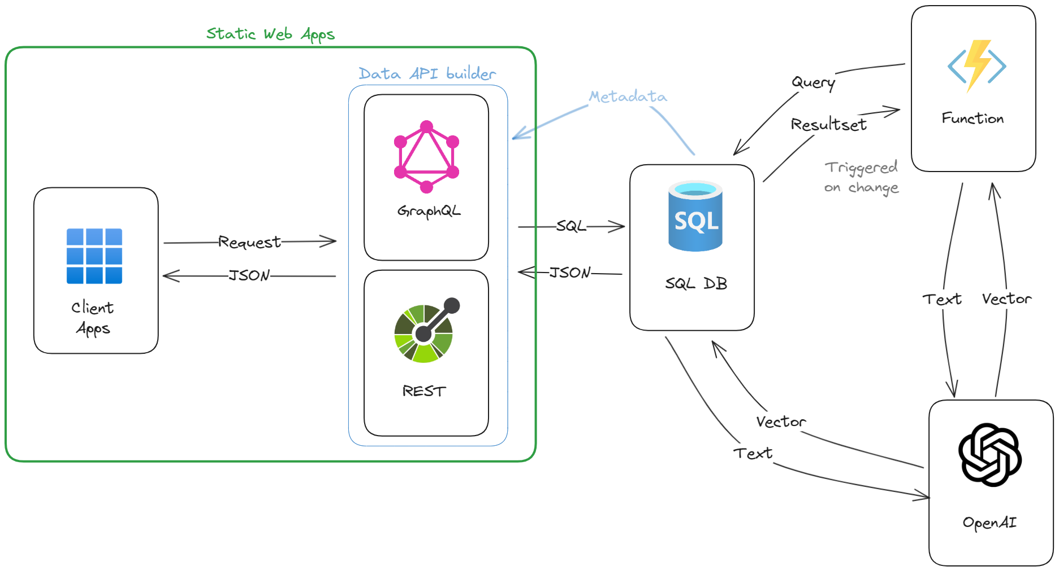
Session Recommender (Similarity Search) Architecture
Azure SQL DB + REST endpoint (Open AI or any other REST API...)
https://github.com/Azure-Samples/azure-sql-db-session-recommender-v2
Try it: https://ai.chicago.vslive.com/
Notes:
Speaker: Muazma

Slide 13
Resources
aka.ms/sqlai
aka.ms/sqlaisamples
aka.ms/freedb
aka.ms/dab
Hands-on Lab
https://github.com/AzureSQLDB/ContentSafetyLab/
Blogs
https://devblogs.microsoft.com/azure-sql/
https://techcommunity.microsoft.com/t5/azure-sql-blog/bg-p/AzureSQLBlog
Azure SQL DB Essentials
https://learn.microsoft.com/en-us/shows/azure-sql-database-essentials/

